Slide 1





GROUP 1 & 2
INFANT CRY
DETECTOR

Slide 2

GROUP MEMBERS
1. AMPOMAH MONNEY JEFFREY
2. FRIMPONG BRIANA OPOKU
3. ⁠JOHN GREENFIELD ATIBILA
4. ⁠CALEB KWADWO BOAKYE
5. NODDY-RICH TAKYI BOATENG
6.SHARON ASUMADU
7. CHERYLE DEPHNEY DANIELLA
8. HASFORD ROBERT HENRY
9. ⁠ADJETEY VINOLIA NAA AYORKOR
10. ⁠NII ARMAR ARCHER

Slide 3

TABLE OF CONTENTS
Problem Statement
Methodology
Approach
Code & Schematics
Demonstration
Conclusion

Slide 4
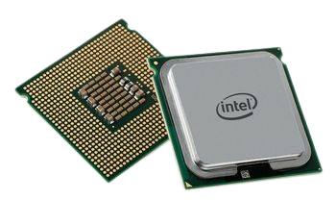
PROBLEM STATEMENT
Parents and caregivers often struggle to hear or respond to a baby’s cries immediately, especially when they are in another room or occupied with other tasks. This delay in attention can lead to increased distress for the baby and anxiety for the caregiver. The lack of an efficient monitoring system makes it difficult to promptly address the baby’s needs.

Slide 5
METHODOLOGY
The Infant Cry Detector aims to solve this problem by using an Arduino-based system to detect a baby’s cry and provide immediate visual and auditory alerts to notify guardians. Additionally, it plays soothing lullabies to help calm the baby, ensuring a more responsive and comforting environment.
APPROACH
Components Used
1. Arduino Uno: Central controller for all components.
2. Potentiometer: Simulates sound intensity for testing purposes.
3. LCD Display (16x2): Displays cry level and status messages.
4. LEDs (Green, Yellow, Red): Indicate cry intensity levels (Low, Medium, High).
5. Buzzer: Mimics a baby’s cry and plays soothing sounds.
6. Vibration Motor: Replaces the buzzer for alerts when cry levels are high. 7. Resistors, Breadboard, and Jumper Wires: For circuit connections.

Slide 6
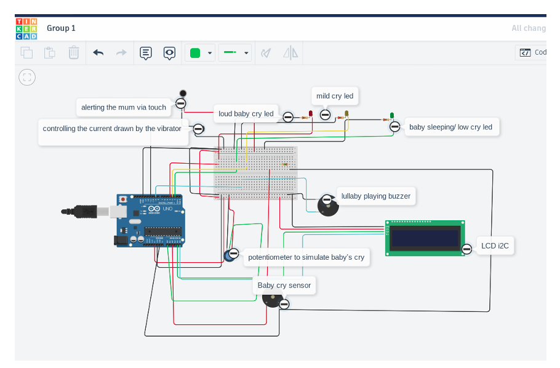
Potentiometer: Connected to analog pin A0. LCD Display: Connected to I2C pins of the Arduino.
LEDs: Connected to digital pins 2, 3, and 4 for green, yellow, and red LEDs, respectively.
Buzzer and Motor: Connected to pins 9 and 11. The code reads the potentiometer values, which are mapped to a range of 0 to 255.
Based on the intensity: Low Intensity: Green LED is activated; LCD displays 'Baby Not Crying.'
Medium Intensity: Yellow LED is activated, mild vibration occurs, LCD displays 'Playing at the moment.' High Intensity: Red LED is activated, strong vibration occurs, LCD displays 'Baby is Crying.'
The buzzer is programmed to mimic a baby’s cry continuously before the LCD displays any status.

Slide 7
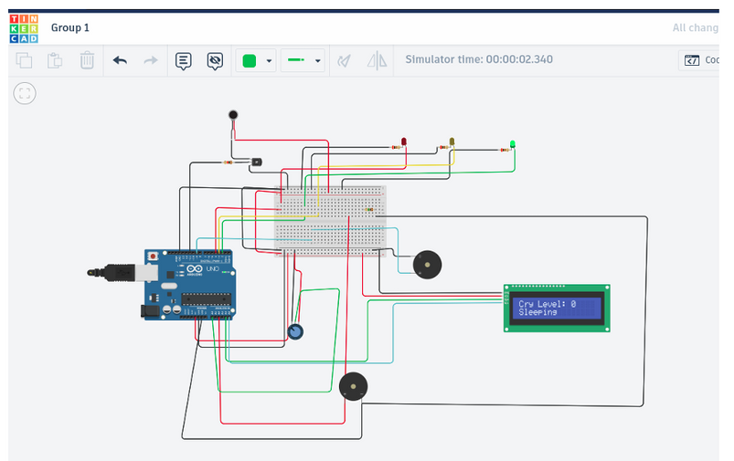
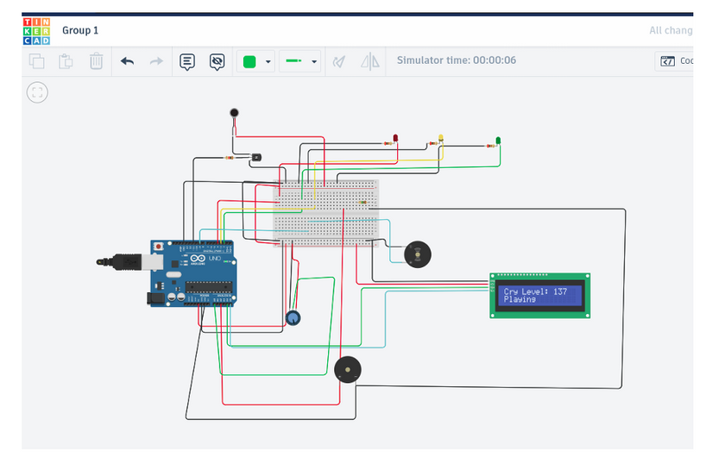
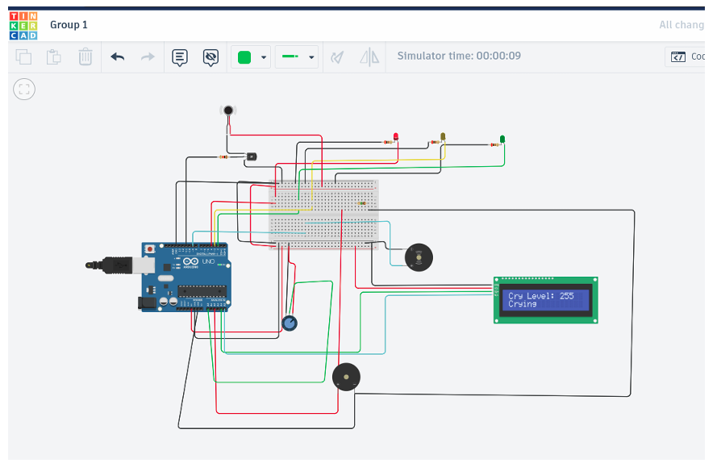
When the cry level is low, the green LED lights up, and the LCD displays a sleeping status.
When the cry level is moderate, the yellow LED lights up, mild vibration is activated, and the LCD displays a playful status.
When the cry level is high, the red LED lights up, strong vibration is activated, and the LCD displays a crying status.

Slide 8
CONCLUSION
The Infant Cry Detector provides a straightforward, efficient way to monitor a baby’s cries and alert the caregiver. The project effectively demonstrates how various components can be integrated to detect and respond to different cry intensities.
CHALLENGES ENCOUNTERED
Simulating real cries: Due to the absence of a microphone, a potentiometer was used. Buzzer Interference: Continuous buzzing before the LCD update required careful timing management.
FUTURE IMPROVEMENTS
1. Incorporating a real sound sensor for detecting actual baby cries.
2. Wireless notifications via Bluetooth or Wi-Fi to alert caregivers remotely.t
3. Battery operation for portability.
4. Customizable lullabies to provide comfort for the baby.

Slide 9

THANK YOU

